Slide 1

BUSINESS INTELLIGENCE
CASE STUDY : Employee Internal Audit
Submitted By :
Roll : 208W1A12A0

Slide 2
INTERNAL AUDIT :
Internal Audit is an independent, objective, assurance to add value to and improves an organization’s operations.
It is disciplined approach to evaluate and improve the effectiveness of Risk Management , Control and governance processes.

Slide 3
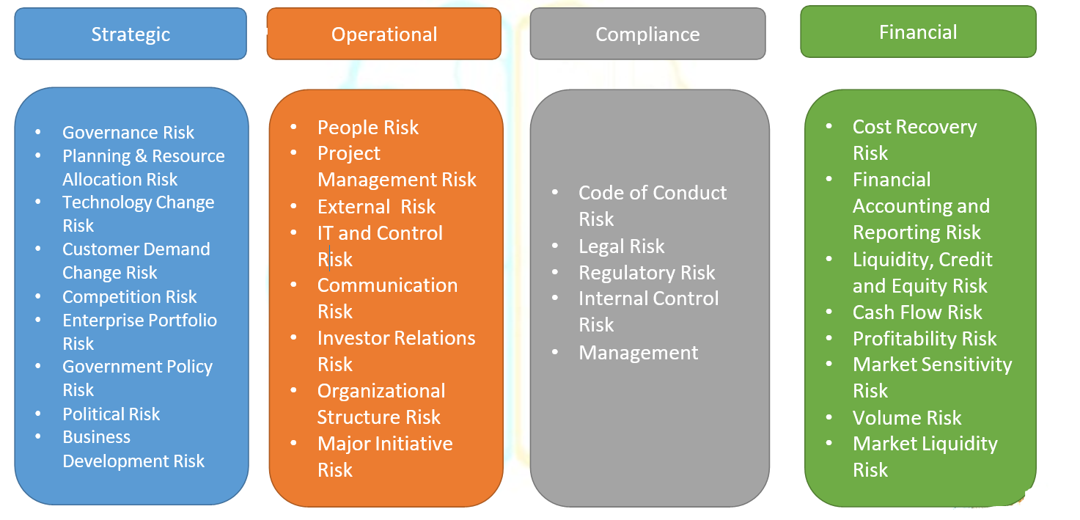
INTERNAL AUDIT MITIGATE THE RISK

Slide 4
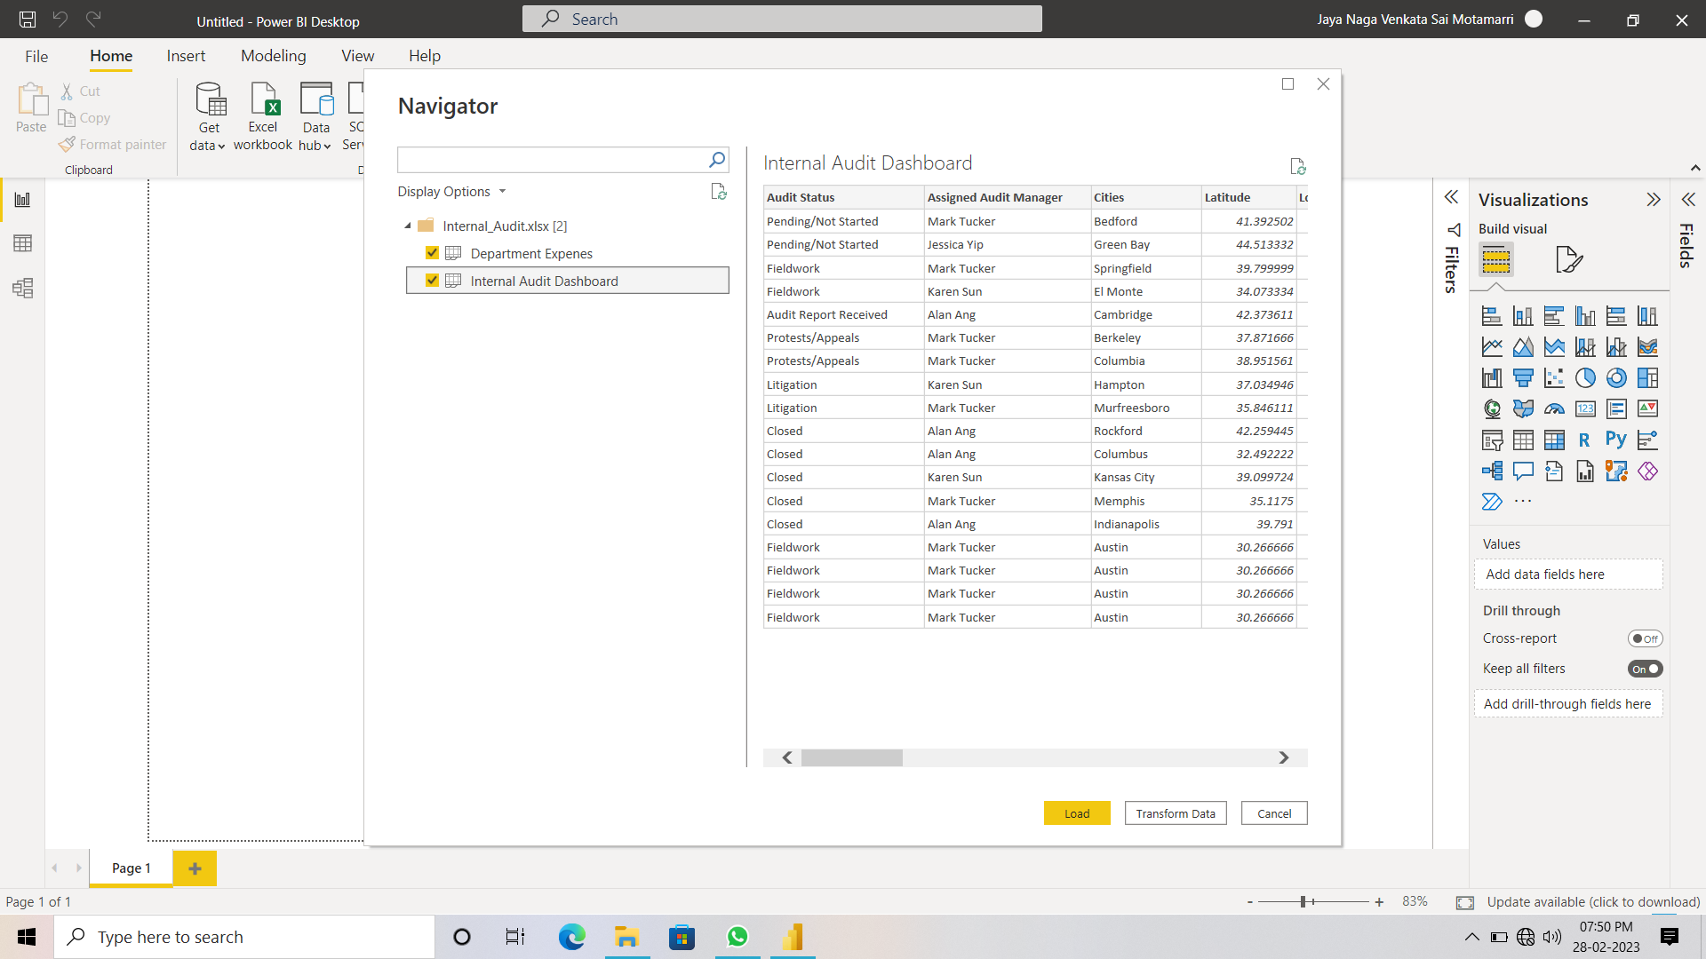
DATSET PREVIEW & LOAD

Slide 5
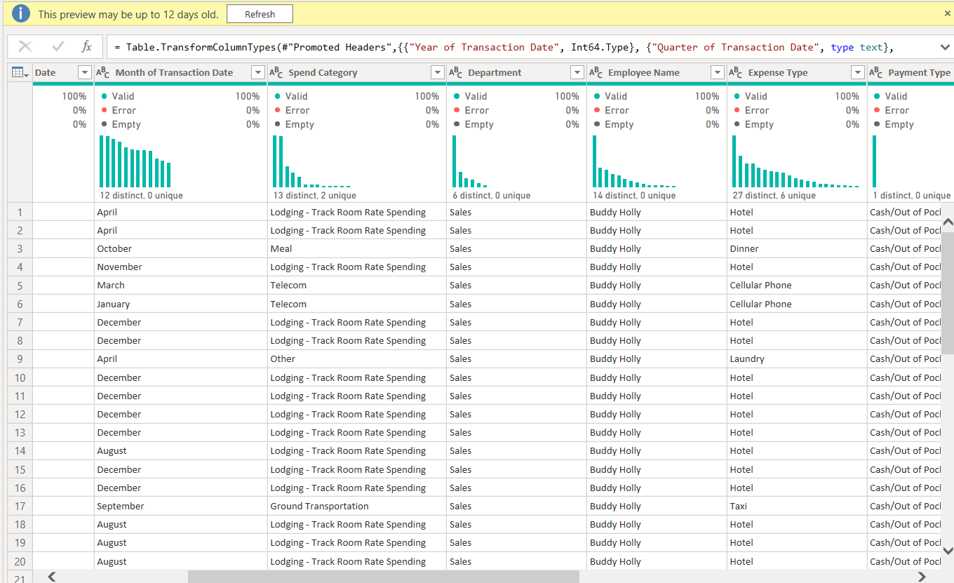
Minimum Basic Analysis Of Each Attribute In The Dataset

Slide 6
Dataset Details :
Contains 2 tables and They are
Department Expenses table
This Table Contains 13 Attributes and 10,000 Tuples.
Audit Table
This table Contains 18 Attributes and 18 Tuples only.

Slide 7
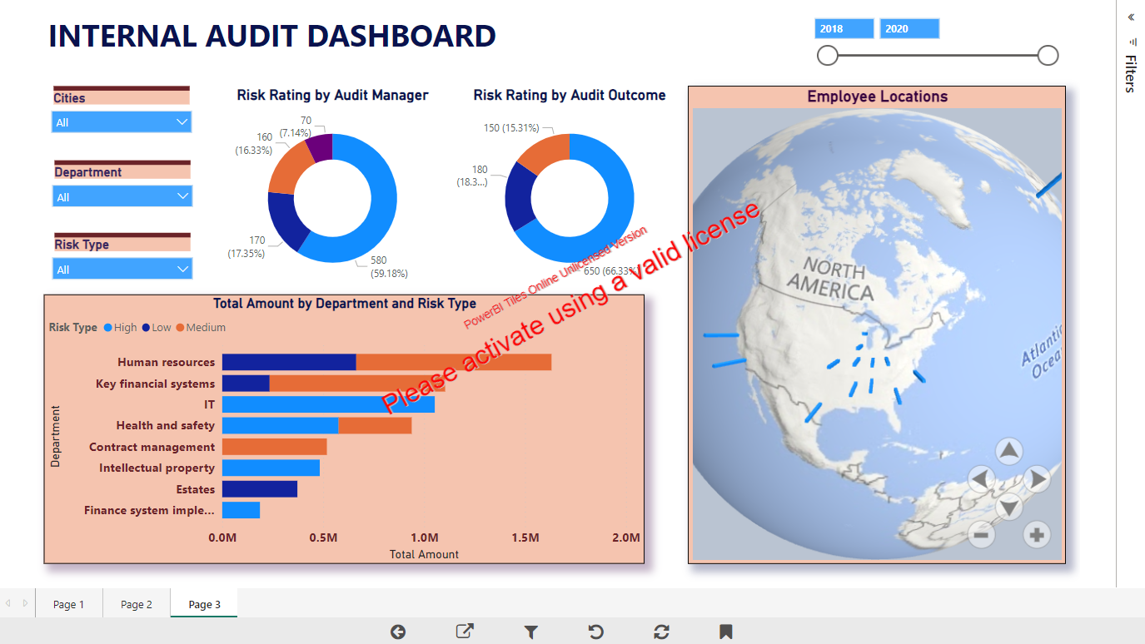

Slide 8

This Photo by Unknown Author is licensed under CC BY-SA

